Slide 1
Comparing tools for mapping NGS reads
Ruffalo M, LaFramboise T, Koyutürk M. (2011), “Comparative analysis of algorithms for next-generation sequencing read alignment.” Bioinformatics, 27 (20):2790-2796.
doi:10.1093/bioinformatics/btr477.
Schbath S, Martin V, Zytnicki M, Fayolle J, Loux V, Gibrat JF (2012), “Mapping reads on a genomic sequence: an algorithmic overview and a practical comparative analysis.” J Computational Biology, 19(6): 796-813. doi:10.1089/cmb.2012.0022.
Presented by Hershel Safer
in Ron Shamir’s group meeting
on 11/7/2012

Slide 2
Outline
Background
Algorithmic approaches to large-scale mapping of short reads
Experiments
Results

Slide 3
What is NGS mapping?
Many NGS applications are based on comparisons to a known reference genome.
The first step in analyzing a resequencing project is mapping the reads to the reference genome.
Complications include:
Genetic variation in the population
Sequencing error
Exact and approximate repeats in the genome
Short read length
Massive number of reads to map
Notes:
Known reference genome as opposed to applications based on de novo sequencing and assembly, which I discussed in my last journal club presentation

Slide 4
Goals of this talk
Discuss these papers
Learn about algorithmic approaches to short-read mapping
Highlight different approaches to design of computational simulation experiments

Slide 5
Outline
Background
Algorithmic approaches to large-scale mapping of short reads
Experiments
Results
Notes:
2 general algorithmic approaches

Slide 6
Hash-based approaches
Suppose that all reads have the same length, say 36 bp
Idea: Hash all 36-mers in the genome and list locations of each. Then any read can be found in (close to) constant time.
Takes too much RAM and even too much disk
Does not deal with mismatches
Idea: Store k-mers for k << read length (say, k=9). Map k-mer from left end of read and use dynamic programming (DP) to see if rest of read maps to genome. This is called seed-and-extend.
Short seeds may be highly repeated in genome, leading to wasted effort in the extend phase.
Idea: Map non-overlapping k-mers that cover each read (and only extend if they all map consistently).
Still can’t handle mismatches
Notes:
Need to precompute information because of the size of the problem
List locations in time linear in # locations
Prefer to have hash in RAM because of speed considerations
Left end of read has better quality with current technologies

Slide 7
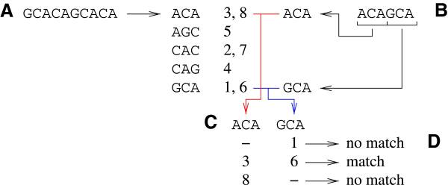
Hashing with no mismatches: Example
Notes:
FIG. 1. The hashing algorithm.
(A) The genome is cut into overlapping 3-mers, and their respective positions in the genome are stored.
(B) The read is cut into 3-mers. The 3-mers from the reads are compared to 3-mers from the genome using a hashing procedure.
(C) Positions for each seed are sorted and compared to the other seeds.
(D) Compatible positions are kept.

Slide 8
Hashing with mismatches
Idea: Only require that enough short k-mers map consistently. Scan other regions to see if they match without too many errors.
Q-gram filtering: Map all k-mers (not just non-overlapping ones) to genome. If enough match in a small region, align the read more carefully.
Notes:
With non-overlapping k-mers, if don’t require all to map consistently, can accommodate sequencing errors and genetic variation.
FIG. 2. The seed and extend algorithm.
A read ATCA is sought for in GATTACA, using seeds of size 2, with one error.
Each seed maps once (left part).
After extension of each seed (right part), it turns out that only one mapping contains only one error.

Slide 9
Hashing with mismatches: Spaced seeds + filtering
Need to decrease k as allowed number of errors increases. Small k-mers, however, match at too many positions. Rarely use k<10.
Spaced seeds include “don’t care” positions that match any base. Increase sensitivity at the expense of computation time.
Idea: Extend less often by filtering. When a seed is mapped, count how many of each base occur in the surrounding area of the genome and the read. Only extend if the counts are close enough to accommodate the allowed number of errors.
Notes:
Fig 2. (B) A read GTCA is sought for in GATTACA, using spaced seeds of size 2, with two errors.
Notice that using simple seeds would not retrieve any hit.
The spaced seed mask is used to generate the seeds: xC and xA.
The hashing algorithm retrieves many hits.
After extension, three hits are kept.
Seed-filter-and-extend

Slide 10
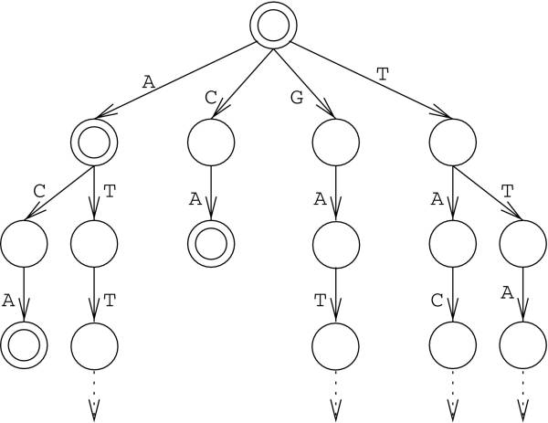
Suffix trees
In a suffix tree, paths from the root to the leaves are in one-to-one correspondence with the suffixes of a string (the genome).
Genome = GATTACA
Can build tree in space and time proportional to genome length, but it still takes a lot of space for the human genome.
Notes:
Use this genome string for the rest of the algorithm section.
Mapping a read is easy: Just start from the root and see if read exists as the beginning of a suffix.
Cannot map GAG, which does not exist in string.
Does not accommodate errors.
Mapping time is linear in length of read, even if read falls in repeated region
Mpscan stores reads in suffix tree and then scans genome. Other tools do preprocessing to store genome because # reads is so large.

Slide 11
Suffix arrays
A suffix array is the set of suffixes of a string, sorted lexicographically.
Store only the position at which each suffix begins. Together with a single copy of the string, this is sufficient to recover every suffix and saves a lot of space.
A suffix array is a list of numbers.
Suffixes | Sorted suffixes | Positions
GATTACA$ | ACA$ | 5
ATTACA$ | ATTACA$ | 2
TTACA$ | A$ | 7
TACA$ | CA$ | 6
ACA$ | GATTACA$ | 1
CA$ | TACA$ | 4
A$ | TTACA$ | 3
$ | $ | 8
Notes:
$ is sentinel for end of string. Sorts last.
Table in article has errors

Slide 12
Connection between suffix trees and suffix arrays
First column of suffix array = labels on edges from root
First two columns = paths from root to level-2 nodes
Etc.
Suffixes | Sorted suffixes | Positions
GATTACA$ | ACA$ | 5
ATTACA$ | ATTACA$ | 2
TTACA$ | A$ | 7
TACA$ | CA$ | 6
ACA$ | GATTACA$ | 1
CA$ | TACA$ | 4
A$ | TTACA$ | 3
$ | $ | 8
Notes:
Would like to get space savings of suffix array and be able to traverse the suffix array as we can do with the suffix tree.

Slide 13
Burrows-Wheeler transform (BWT)
Consider suffixes as being represented on a cylinder, so that the beginning of the string appears after the end-of-string sentinel (i.e., write down all circular permutations of string).
BWT = Last column of cylinder (i.e., a list of characters)
Suffixes | Sorted suffixes | Positions | Cylinder | BWT
GATTACA$ | ACA$ | 5 | ACA$GATT | T
ATTACA$ | ATTACA$ | 2 | ATTACA$G | G
TTACA$ | A$ | 7 | A$GATTAC | C
TACA$ | CA$ | 6 | CA$GATTA | A
ACA$ | GATTACA$ | 1 | GATTACA$ | $
CA$ | TACA$ | 4 | TACA$GAT | T
A$ | TTACA$ | 3 | TTACA$GA | A
$ | $ | 8 | $GATTACA | A
Notes:
Suffix array + BWT is very compact: a vector of numbers (the suffix array) and a vector of characters (the BWT). Each vector is the same length as the genome.

Slide 14
Retrieving the suffix array from the BWT
Genome = GATTACA$
Cylinder | BWT | Sort | Concat | Sort | Concat | Sort
ACA$GATT | T | A | TA | AC | TAC | ACA
ATTACA$G | G | A | GA | AT | GAT | ATT
A$GATTAC | C | A | CA | A$ | CA$ | A$A
CA$GATTA | A | C | AC | CA | ACA | CA$
GATTACA$ | $ | G | $G | GA | $GA | GAT
TACA$GAT | T | T | TT | TA | TTA | TAC
TTACA$GA | A | T | AT | TT | ATT | TTA
$GATTACA | A | $ | A$ | $A | A$A | $GA
Notes:
BWT copied from previous slide
Sort BWT column (lexicographically) (col 3)
Observe that this corresponds exactly to the first column of the cylinder suffix array
We now have the last and first columns of the cylinder suffix array (the last column being the BWT).
Since we work on a cylinder, the last column is also the one which is right before the first column.
So concatenating the two columns gives the set of all two-letter words of the genome. (col 4)
Sort again to get the first two columns of the cylinder suffix array. (col 5)
Prepend BWT (col 6) and sort (col 7) to get the three first columns of the cylinder suffix array
Etc.

Slide 15
Finding a word with BWT
Proceed right-to-left, always looking for the string that precedes the portion that has already been found.
Use BWT & sorted BWT = last & first columns of cylinder
Example: Look for GAT in GATTACA
BWT | Sorted
T | A
G | A
C | A
A | C
$ | G
T | T
A | T
A | $
BWT | Sorted
T | A
G | A
C | A
A | C
$ | G
T | T
A | T
A | $
Notes:
Rebuilding the suffix array from BWT is an inefficient way to find a word
We want to traverse the array as for the suffix tree: letter by letter
Do this with two character vectors and supporting data structures
Work backwards in the read, so find all occurrences of T (in red, lines 6 & 7) CLICK. Do this in constant time with additional data structures. Since the array is sorted, work with intervals of rows (here 6:7).
The corresponding characters in BWT are A and T—these are the only letters that precede T in the genome. We want the A. CLICK
Which letters precede AT in the genome? If we had the set of pairs of consecutive letters, as we did on the previous slide, we would use BWT to find the letters that appear before the AT. But we have only the first column (the A). So focus on A rows in sorted transform. CLICK
To which of the three A rows does the AT correspond? The A from the AT was the second occurrence of A in the BWT, reading from top to bottom. So we want the second row of As. CLICK
The preceding letter is a G, and the string GAT has been found

Slide 16
Comments
BWT with mismatches: A currently active field of research
Implementation is important for speed and disk use
Prefer to keep data structures in RAM for speed, but need to worry about size.
Representing 4 bases using 2 bits—what about Ns?
Bitwise operations to parallelize string comparison
Caching
Notes:
Some tools transform Ns into a random choice of nucleotide, some to a fixed base

Slide 17
Mapping quality
What is the probability that a mapping is correct? The answer is complicated by the issues mentioned earlier.
Many tools try to estimate mapping quality. The user may have the option to filter matches based on the probability of a correct match rather than on the number of alignment errors.
Quality scores generally use the Phred idea of a log10-scaled probability that the mapping is incorrect. Scores typically range from 0–60; 0 corresponds to a very low-quality mapping, ≥30 is very good. p=30 means 10^{-3} probability of being incorrect.
Note: Phred scores refer to the quality of the reads. The scores reported by these tools refer to the quality of the mapping.

Slide 18
Outline
Background
Algorithmic approaches to large-scale mapping of short reads
Experiments
Results

Slide 19
Tools evaluated
Tool | Algorithm | Threads | Gaps | Mismatches | Ruffalo | Schbath
BWA | BWT | ✓ | ✓ | ✓ | ✓ | ✓
Novoalign | Hash ref | ✓ | ✓ | ✓ | ✓ | ✓
Bowtie | BWT | ✓ |  | ✓ | ✓ | ✓
SOAP2 | BWT | ✓ |  | 2 | ✓ | ✓
BFAST | Hash ref | ✓ | ✓ | ✓ |  | ✓
SSAHA2 | Hash ref |  |  | ✓ |  | ✓
MPscan | Suffix tree |  |  |  |  | ✓
GASSST | Hash ref | ✓ | ✓ | ✓ |  | ✓
PerM | Hash ref |  |  | ✓ |  | ✓
mrFAST | Hash ref | ? | ? | ? | ✓
mrsFAST | Hash ref | ? | ? | ? | ✓
SHRiMP | Hash ref | ? | ? | ? | ✓
Notes:
Tools not always run with default parameters. This affects results.
Novoalign is proprietary. Claims high accuracy.
Bowtie: Small memory footprint—1.3GB for entire human genome. Does not guarantee best mapping if no exact match exists; may not align some alignable reads. User can choose to improve accuracy at expense of speed.
SOAP: Specifically for detecting and genotyping SNPs
mrFAST & mrsFAST: Report all mappings, not just best one. Intended for detecting structural variants.
SHRiMP: Focus is mapping SOLID color-space reads
Schbath mentions additional tools that were not included in the test

Slide 20
Goals in comparing NGS mapping tools
How do tools compare in terms of accuracy and speed?
Questions raised by Ruffalo:
How do complicating factors affect the accuracy and speed of mapping tools?
Identify factors to consider in choosing a tool for a particular application. Mapping tools are developed for different purposes and so are optimized for different criteria, which may affect their performance in these evaluations.
Schbath took issue with the experimental design of Ruffalo and wanted to make assessments using more “controlled” sets of reads.

Slide 21
Additional questions addressed by Schbath
Can tools systematically map reads that appear in the genome without errors?
Can tools map reads with the maximum number of mismatches allowed in the alignments?
For reads that occur multiple times in the genome, do tools retrieve all occurrences?
Do reads reported as being unique really occur only once?

Slide 22
Approaches of the two comparisons
Ruffalo
Tool to simulate NGS runs. Parameters include sequencing error, indels, coverage. Can also create artificial genomes.
Read lengths are normally distributed with specified mean. For paired ends, read length is fixed and insert size is normally distributed.
Sequencing error rate is specified and applied independently to each base of a region selected as a read.
Can specify indel rate and mean length
Schbath
Read lengths and errors / read are constant per experiment to make experiments more “controlled”
Notes:
Indels are for assessing robustness of mapping tool

Slide 23
Performance measures
Accuracy: Fraction of reads mapped to the correct location.
Runtime: indexing and mapping
Ruffalo reports w.r.t. changes in sequencing error rate, indel sizes, and indel frequencies

Slide 24
Performance measures, cont.
Ruffalo
Tools that report all matching positions are penalized by typical measures of incorrect mapping, as a read may map well to multiple positions because of paralogous regions.
Define notions of strict and relaxed incorrect mapping. The relaxed version is not supposed to penalize incorrect mappings if the correct mapping is found. This is only relevant if multiple locations are reported. The text and equations seem to me to disagree. In any event, this seems to me to be overkill.
Incorporated threshold on mapping quality. I think that the reported results did not use this in a realistic fashion.
Schbath
Reports separately for reads with unique and multiple locations

Slide 25
Experimental data (genomes & reads)
 | Ruffalo | Schbath
Human genome (length) | hg19 (3 Gb) | GRCh37 (2.7 Gb)
2nd genome (length) | Artificial (500 Mb) 100 repeats, each 500 bp | Concatenation of bacterial genomes (1.7 Gb)
Read lengths | μ=50 | 40
# reads | 5e5 | 10e7
Errors | Rate [0, 0.1] Fixed 0.01 | 0 3 / read
Indel size | 0 (varying error rate) [2, 16] (varying indel size) 2 (varying indel frequency) | None
Indel frequency | 0 (varying error rate) 0.2 (varying indel size) [1e-5, 1e-2] (var. indel freq) | None
Notes:
The two human genomes are the same; hg19 is the UCSC numbering (though not mentioned in the text) and GRCh37 is the NCBI numbering (they did mention the source).
Ruffalo did 3 experiments, each varying a different parameter, on each of 2 genomes
Schbath did 2 experiments, with different numbers of errors, on each of 2 genomes
Schbath discusses handling of Ns at length
Error rate for Ruffalo fixed when evaluating effects of indel size and indel frequency
Schbath error rate is much higher than for modern sequencers. This high rate is used more to model variation for resequencing and metagenomics projects

Slide 26
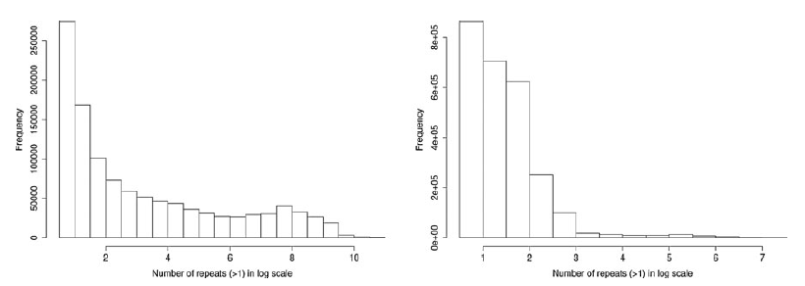
Unique vs. non-unique reads in Schbath
 | Human genome | Bacterial genome
# unique reads | 8,877,107 | 7,379,606
# reads that map to multiple locations | 1,122,893 | 2,620,394
Mean # locations for non-unique (s.d.) | 723 (2,425) | 9 (39)
Max # locations for non-unique | 53,162 | 1,685
# reads with Ns | 49 | 231
Human
Bacterial
Notes:
Schbath considers reads that occur in multiple locations separately from unique reads
Ruffalo lumps them together and uses two definitions of mapping accuracy
Histogram of the logarithm of the number of occurrences of the reads from H0 (resp. B0) occurring more than once in the reference genome

Slide 27
Comparing the approaches
I don’t share Schbath’s concern about the read lengths and number of errors per read being random variables, though NGS sequences typically have fixed length in each run. Since Schbath used a different model in response to Ruffalo, I expected a comparison of the results, but none was provided.
I think that Schbath did not highlight the key difference between the papers. They focused on the differences in the reads, but I think that the substantive differences are in the analysis.
Ruffalo does a parametric analysis, varying three parameters individually
Schbath measures performance in two extreme bases (no errors and many errors)
I think that Schbath reports results in a more informative way

Slide 28
Outline
Background
Algorithmic approaches to large-scale mapping of short reads
Experiments
Results
Notes:
Only discuss results for human genome. Results for 2nd genome are similar in each paper.

Slide 29
Ruffalo: Accuracy with varying error rate
Notes:
These graphs are typical of Ruffalo’s analysis
Fig. 1. Human genome: accuracy with varying error rate.
Shows mapping quality threshold 0,
Same, threshold 10
proportion of reads that have mapping quality of at least 10. -R and -S suffixes denote relaxed and strict accuracy, respectively.
SOAP is not so sensitive to the error rate. This reflects that it was developed for SNP genotyping
Bowtie, BWA, and Novoalign are quite sensitive to the error rate.
I don’t like the figures.
Don’t need repeated legend
Showing threshold 0 is fine, but I would not show only threshold 10 in addition. In practice, use 20 or 30.
I would like to see how the used-read ratio changes with error rate for various values of the cutoff, not just for a score of 10.

Slide 30
Ruffalo: Accuracy with varying indel sizes and frequencies
Notes:
Fig. 3. Human genome: accuracy with varying indel sizes when indel frequency is fixed at 0.05/bp.
mapping quality threshold 0,
same with threshold 10
proportion of reads that have mapping quality of at least 10. -R and -S suffixes denote relaxed and strict accuracy, respectively.
At indel sizes 10 and 16, SOAP discards all reads, producing missing values in (c).
SOAP is again seen to be better for SNP analysis than for coping with indels
mrFAST, mrsFAST, and Novoalign are fairly robust to long indels with a cutoff on the quality scores.
Fig. 4. Human genome: accuracy with varying indel frequencies when mean indel size is fixed at 2.
mapping quality threshold 0,
Same with threshold 10
proportion of reads that have mapping quality of at least 10. -R and -S suffixes denote relaxed and strict accuracy, respectively.

Slide 31
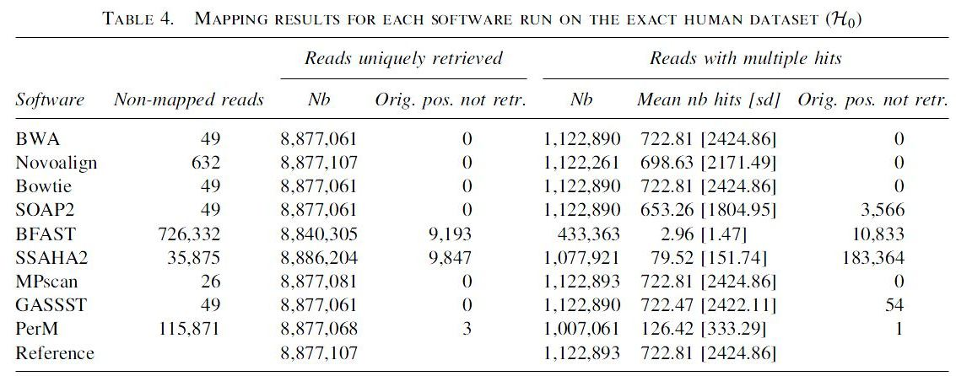
Schbath: Accuracy
Notes:
More detailed comparison from table than from graphs
Table 4: Reference line shows actual numbers for comparison
Unmapped reads are just the 49 reads with Ns for 4 tools. MPscan even mapped some reads with Ns. 3 tools left many reads unmapped.
Novoalign reports the full number of unique reads, but this is a coincidence. It only maps some reads with Ns, so some reads reported as being unique really appear multiple times and were missed in other locations.
Original position retrieved: Looked within complete list of returned reads (different approach than for Ruffalo)
Unique reads vs those with multiple hits
Table 6: SOAP and MPscan do not allow 3 mismatches and so are not included in the mismatch test.

Slide 32
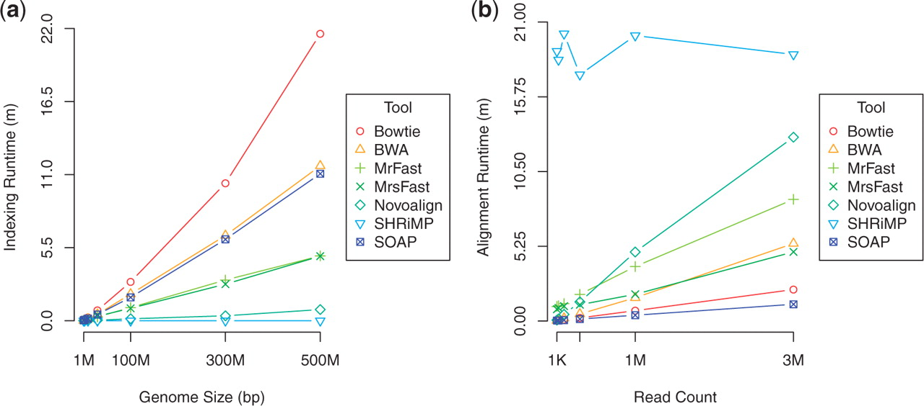
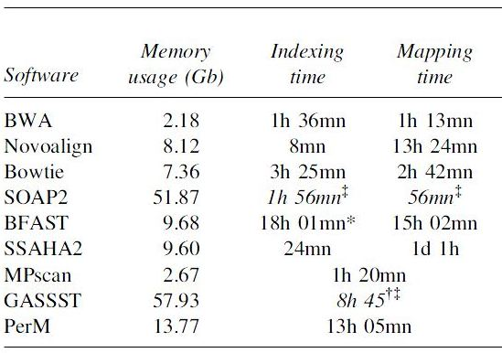
Runtime
Ruffalo
Artificial genomes
Schbath
Human genome
no sequencing errors
Notes:
Again, no need for repeated legend.
I think that mapping time is much more important than indexing time; index once and save the data structure.
Note tools that combine these steps
Tradeoff between indexing and mapping times
Schbath: Since SOAP and GASSST needed so much memory, they were run on a different computer than the other tools

Slide 33
Which tools to use?
Depends on the application
Schbath gives more detailed conclusions
Key: green = good, yellow = mediocre, red = poor
Tool | Accuracy—no errors | Accuracy—errors | Runtime
BWA
Bowtie
MPscan |  | —
GASSST
PerM
Novoalign
SOAP2 |  | —
BFAST
SSAHA2
Notes:
BWA & Bowtie: Map non-Ns, get original positions, fast
Mpscan: Good with no errors, can’t handle 3 errors, fast
GASSST: Good with no errors, but with errors leave many unmapped, and those that are mapped are often not to the right positions. Slow but threadable.
PerM: Leaves many unmapped but returns good positions for those that are mapped
Novoalign: no errors – leaves many unmapped but good positions; errors – opposite
SOAP2: Aimed at SNP genotyping. Has trouble mapping reads that appear multiple times.
BFAST, SSAHA2: Poor accuracy

Slide 34
References
Alkan et al. (2009), Nature Genetics 41:1061. (mrFAST)
Burrows et al. (1994), Digital Equipment Corp., Technical Report 124. (Burrows-Wheeler transform)
Chen et al. (2009), Bioinformatics 25:2514 (PerM)
Ewing and Green (1998), Genome Research 8:186. (Phred)
Ferragina and Manzini (2000), FOCS p. 390. (Burrows-Wheeler transform)
Hach et al. (2010), Nature Methods 7:576. (mrsFAST)
Homer et al. (2009), PLoS ONE 4:e7767. (BFAST)
Langmead et al. (2009), Genome Biology 10:R25. (Bowtie)
Li et al. (2009), Bioinformatics 25:1966. (SOAP2)
Li and Durbin (2009), Bioinformatics 25:1754. (BWA)
Li and Durbin (2010), Bioinformatics 26:589. (BWA)
Ning et al. (2001), Genome Research 11:1725. (SSAHA2)
Novocraft, www.novocraft.com. (Novoalign)
Rivals et al. (2009), Lecture Notes in Computer Science 5724:246. (MPscan)
Rizk and Lavenier (2010), Bioinformatics 26:2534. (GASSST)
Rumble et al. (2009), PLoS Computational Biology 5:e1000386. (SHRiMP)

